Slide 2


Slide 3
Content Warning
This presentation serves as discussion points rather than factual educational information. Topics presented are by no means comprehensive to the subject in question.
Material contained is intended for mature audiences and includes Adult Content, which may not be suitable for some. Gags used are UK-centric. Viewer discretion is expected.
If you stay for this presentation, your discretion and consent is implied.

Slide 4
Assumed Knowledge
Currency Pair / Futures / Forwards / Options
Orderbook / Price Ladder
ECN (Facilitators) / Brokers / Exchange (Firm Prices)
Bilateral / Multilateral / Credit Agreements / Limits

Slide 5
What is FX
The cost of any currency is expressed in its exchange rate, which is like a currency’s price tag.
The rise or fall of the exchange rate itself depends on several factors, including inflation, interest rates, trade balance, and overall economic and political stability.
Currency pairs have different exchange rates because the global demand for each currency - meaning the demand for the country’s goods or financial assets – varies.

Slide 6
Table of Contents
Where can I trade FX?
Where do the machines live?
What do the prices look like?
Who does What and When?
Curiouser and Curiouser
Need for Speed
Outro

Slide 7
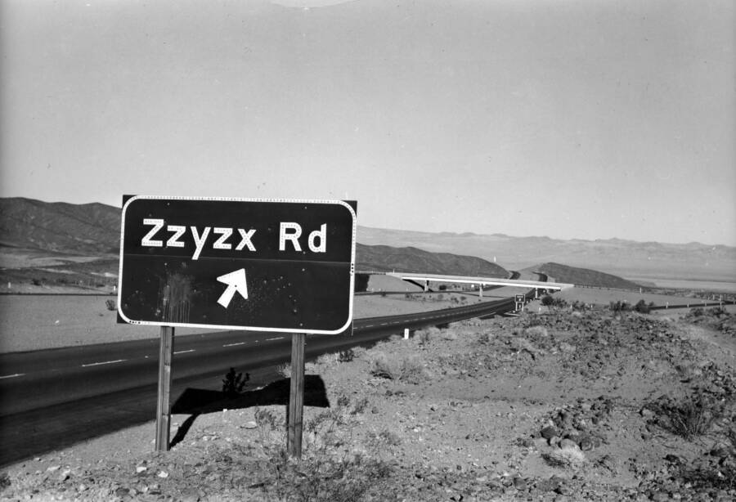

Slide 8


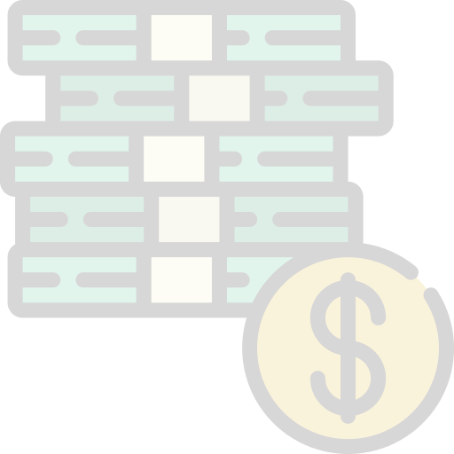














Where Can You Buy?

Slide 9





Who are they really?

Slide 10
Where Can You Buy?

Slide 11

Where Can You Buy?

Slide 12
Who are they really?

Slide 13
What Can You Buy?
EURSEK
USDRUB
USDCAD
EURNOK
EURDKK
USDCHF
GBPUSD
EURCHF
EURPLN
EURHUF
EURUSD
EURRON
USDCNY
USDJPY
XAGUSD
USDKRW
USDTRY
XAUUSD
USDCNH
USDTWD
XPDUSD
USDHKD
AUDJPY
USDMXN
USDINR
XPTUSD
NZDJPY
USDTHB
USDMYR
USDSGD
USDIDR
USDBRL
AUDUSD
USDZAR
NZDUSD

Slide 14
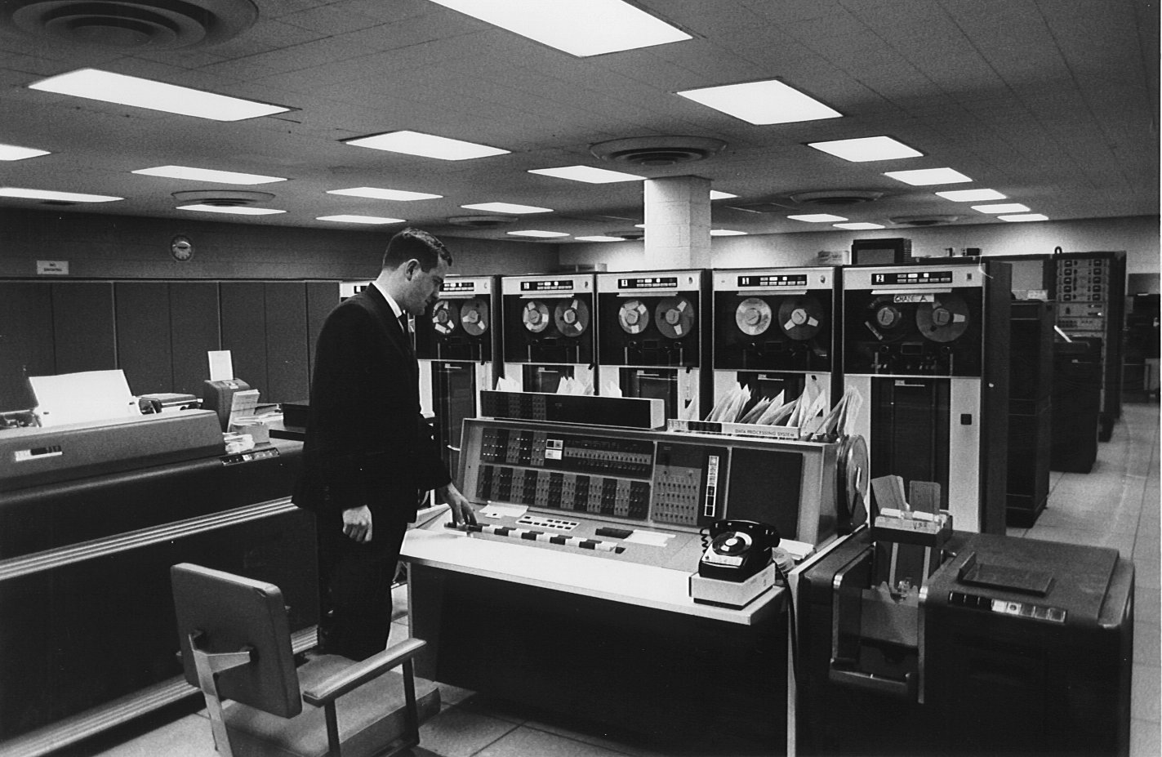

Slide 15

Where do my orders actually go?

Slide 16

World’s Local Hubs

Slide 17

Sun Worshipers

Slide 18
Matching in America Gets Adopted
EURSEK
USDRUB
USDCAD
EURNOK
EURDKK
GBPUSD
EURCHF
EURPLN
EURHUF
EURUSD
EURRON
USDCNY
USDJPY
XAGUSD
USDKRW
USDTRY
XAUUSD
USDCNH
USDTWD
XPDUSD
USDHKD
USDMXN
USDINR
XPTUSD
USDTHB
USDMYR
USDSGD
USDIDR
USDBRL
AUDUSD
USDZAR
NZDUSD

Slide 19

Empire 2.0 Strikes Back
USDCAD
GBPUSD
USDHKD
AUDUSD
NZDUSD

Slide 20
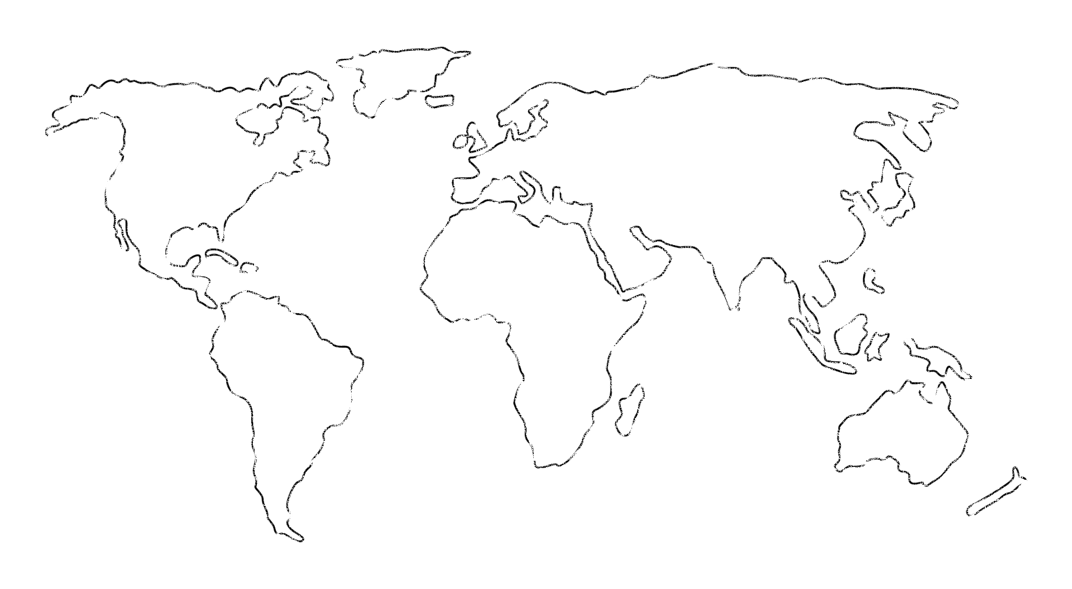
Dark Pool vs MidMatch
Question
Dark Pool
MidMatch
Where are they (mostly)
Banks, Market Makers
Lit Venues
Is there an orderbook
Yes
No
Are orderbooks published
No
No
What info is contained in an order
Price, Size, Type
Size(, Type?)
How are orders matched
Price
-
Time
-
Size Priority
Time
-
Size Priority
How do you match on price if you
There is an orderb
ook
, so not
All participants need to stream in
can’t see the price
an issue
mid
-
price.
PnL
is calculated from
difference between
mids.
Monthly process redistributes
PnLs
amongst parties to make it
“fair”. May have speed bumps.
* BGC /
FastMatch
/ 360T

Slide 21
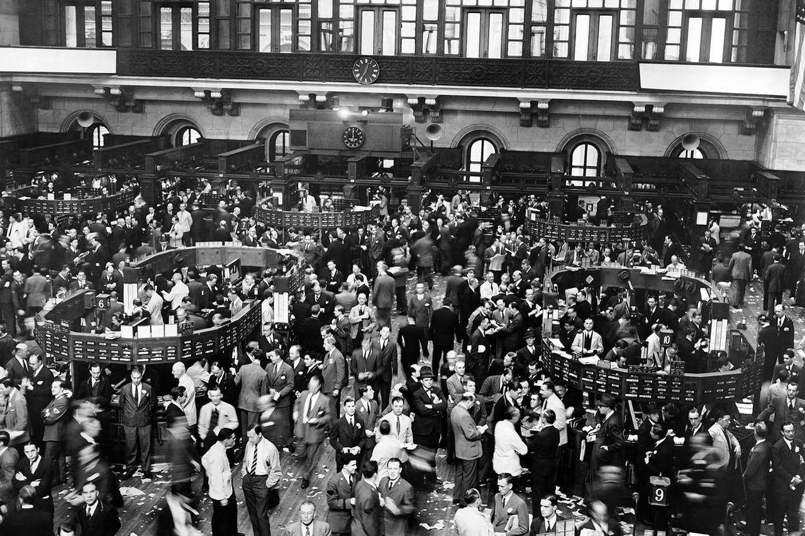

Slide 22











What Makes a Market Maker Tick?

Slide 23
But How much? n*p(x) ≤ p(n*x)

Slide 24
That’s a bargain! Give me more!

Slide 25
More! More!! MORE!!!

Slide 26
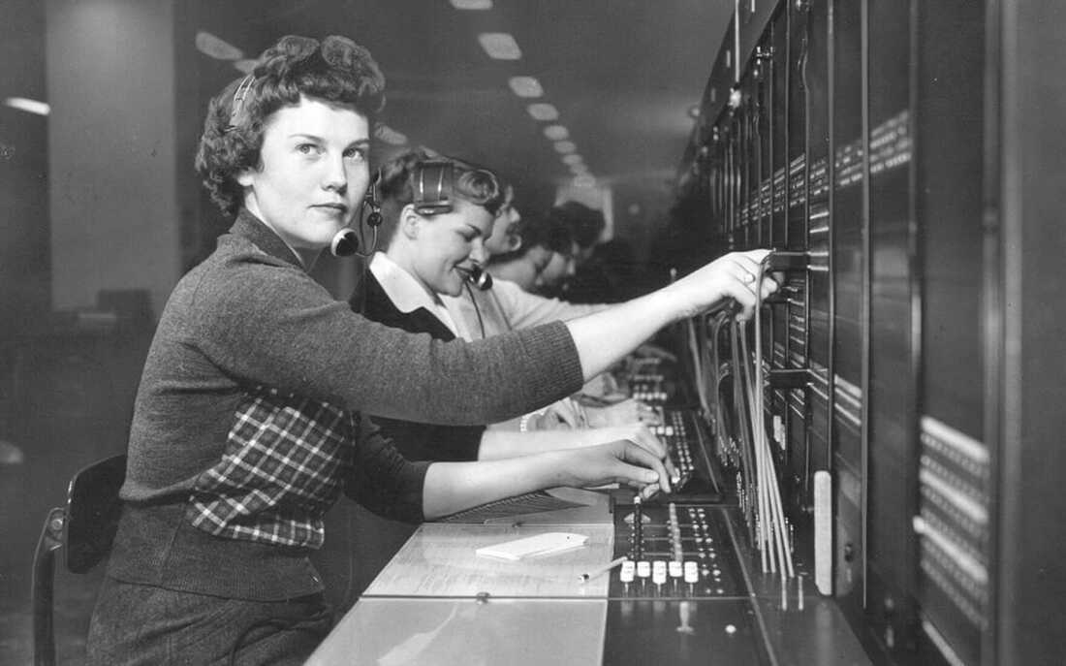

Slide 27
You are open 24/5.5?

Slide 28
Seriously… All Day Long?

Slide 29
How does <A.N.Other> compare?

Slide 30
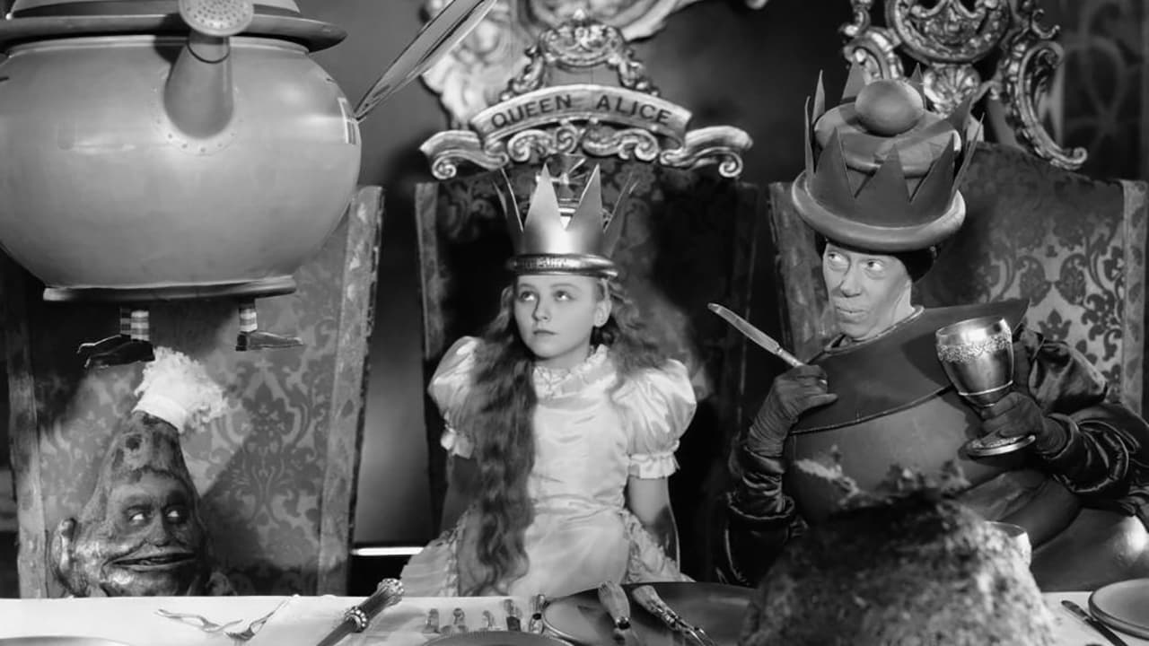

Slide 31
Currency Pair Triangle
Content

Slide 32
NFP

Slide 33
CNH vs CNY
As Mainland China is still not completely open to international foreign exchange and capital markets, the two types of Renminbi still remain a reality to this day:
CNY is onshore RMB currency traded within Mainland China only.
CNH is offshore RMB currency traded outside of Mainland China.
NOTE:
- You CAN actually settle in CNY for international trades
- As of 2009, there is no limit on RMB trade settlements between China and Hong Kong.

Slide 34
USDCNH vs USDCNY

Slide 35
USDHKD

Slide 36
Currenex Stuck Orders

Slide 37
Other bits and bobs…
WYSINWYG
Prices are different from / for everyone
Last Look
Too fast (eg too many orders per second)
Too slow (eg absolute time, too many ticks behind)
Too much Profit / Loss (eg market too volatile, price has moved too much)
Claw back
I lost too much on this trade – can I have some money back please?
Price adjustment
I was only joking about the price I gave you
EFP (Gold you buy on an exchange is not pure enough)

Slide 38
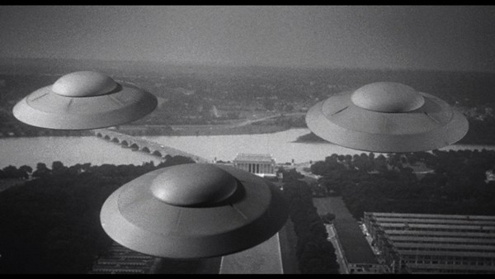

Slide 39
c = f($)
End Points | Latency Round Trip ms
Chicago <-> New York (Cable) | 14.1
Chicago <-> New York (Microwave) | 8.2
London <-> New York (Hiberia Global Financial Network) | 65.5
London <-> New York (Hiberia Express) | 58.8
London <-> Tokyo | 230
London <-> Tokyo (via Atlantic) | 170
Google | ???
Meta | ???
Microsoft | ???

Slide 40







29ms
115ms
4ms
7ms
115ms
32.5ms

Slide 41

AUDUSD
USDJPY
UJ
UJ
UJ
UJ
UJ
AJ
AJ
AJ
AJ
AJ
AJ
AJ
AJ
AUDJPY

Slide 42
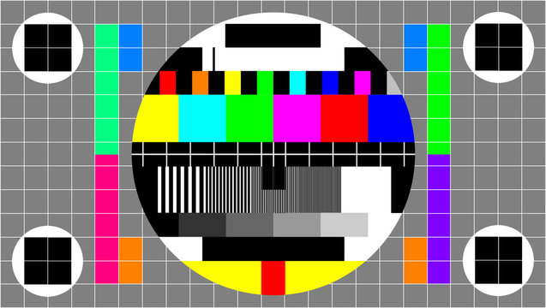

Slide 43
Some Client Offerings
Direct Market Access (DMA)
Trading Analytics
Algorithmic Strategies
Passive / Iceberg
Time- / Volume-based
Opportunistic - Guerrilla, Sniper
Hybrid - Float-Guerrilla, Float Sniper, Price Inline
https://www.credit-suisse.com/media/ib/docs/investment-banking/client-offering/aes-strategy-guide-and-attestation-equities.pdf

Slide 44
Other Episodes
How are you machines actually set up?
How are prices really generated?
Out-takes and mishaps?
What do traders actually do?

